Slide 1

GETTING STARTED WITH VALUE BASED HEALTH CARE
Linnean Initiatief – ICHOM Conference 2023 – Workshop Getting Started with VBHC

Slide 2
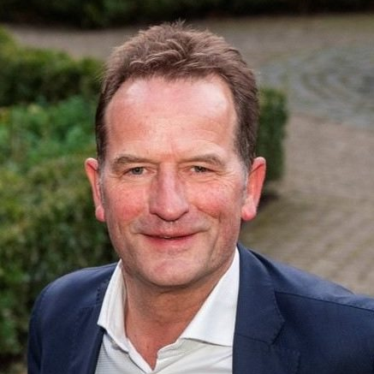
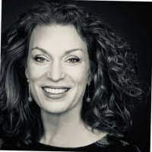
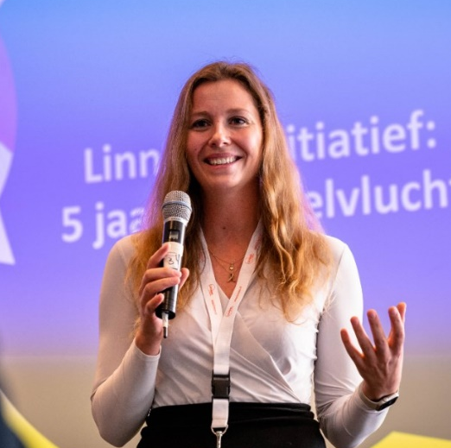
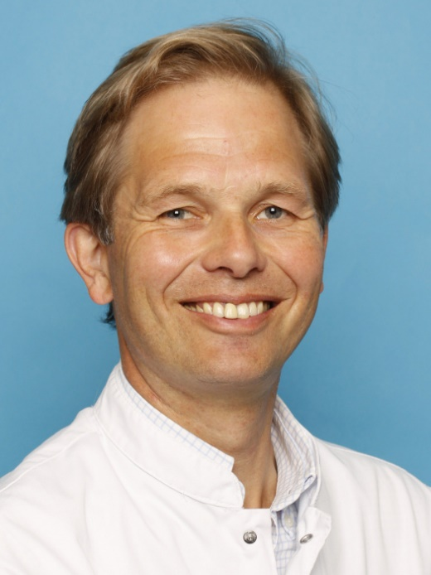
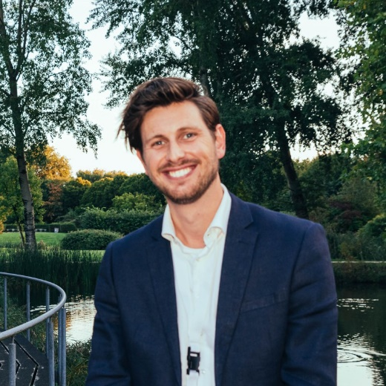
WHO ARE WE?
Arie Franx
Professor of Obstetrics, Erasmus MC
Co-founder & chair Linnean Initiatief
Michele van der Kemp
Founder VDKMP, Value Based Health Care, Clinical Leadership & Care Design
Joliene Munier
Patient advocate, Inspire2Live
Willem Jan Bos
Professor of Nephrology, Outcomes of Care, LUMC
Internist-nephrologist, St. Antonius Hospital
Co-founder & chair Linnean Initiatief
Matthijs van der Linde
Program manager Linnean Initiatief, National Health Care Institute
Linnean Initiatief – ICHOM Conference 2023 – Workshop Getting Started with VBHC
Notes:
Allen

Slide 3
WHO ARE YOU?
Stakeholder group?
How long have you been working on VBHC implementation?
Familiar with the Linnean Initiative network?
Linnean Initiatief – ICHOM Conference 2023 – Workshop Getting Started with VBHC
Notes:
Matthijs
Gemeleerd gezelschap qua kennis- . ervaringsniveau

Slide 4

THE LINNEAN INITIATIVE / GROUP
  Show how value-based healthcare is being implemented in the current healthcare system; identify flaws and challenges as well as provide directions for solutions for the value-based healthcare ecosystem of the future.
History
  2017: ICHOM conference in Washington. Working session with Dutch participants at the Dutch embassy on Linnean Avenue;
  2023: > 1.500 members from all sectors of healthcare.
Characteristics
  Bottom-up: All members participate on a voluntary and personal basis
  Open: Everyone with the ambition to accelerate the pace of value-based health care implementation is welcome to join;
  Independent. No contractors nor clients.
Deliverables
  >25 plenairies on VBHC-topics & site visits
>175 good-practices and motivational stories collected
18 working groups that have resulted in 16 products (and counting)
Linnean Initiatief – ICHOM Conference 2023 – Workshop Getting Started with VBHC
Notes:
Matthijs
We show how value-based healthcare can be implemented in the current healthcare system; identify flaws and challenges as well as provide directions for solutions for the value-based healthcare ecosystem of the future.
Plenairies on value-based healthcare topics: PROMs, PREMs, Multidisciplinary teams, Costs, Reimbursement, Data & IT, a.o.
Site visits to various academic/teaching hospitals, general hospitals, nursing homes and residential care facilities.

Slide 5
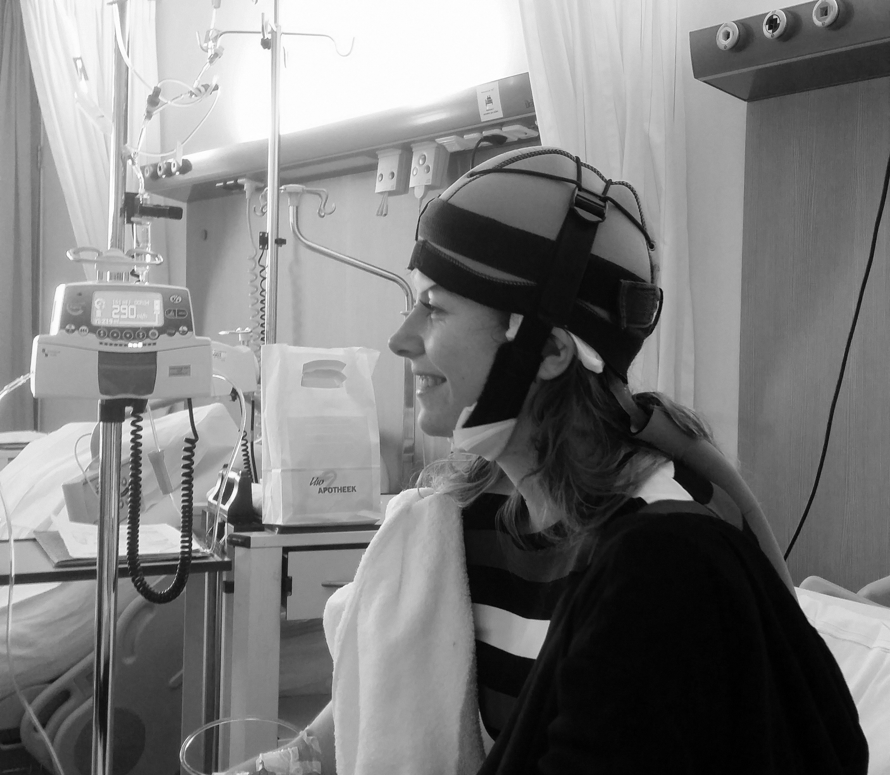
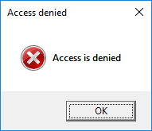

WHY START WITH VBHC? THREE PERSPECTIVES
NATIONAL PERSPECTIVE
Demand and supply in a stretch
Without change we need to compromise on quality, access to and/or affordability of care
PHYSICIAN’S PERSPECTIVE
PATIENT’S PERSPECTIVE
“It’s about why I wanted to become a health care provider in the first place again”
Improving care
New insights from patient reported outcomes
Better support, eg IT
Helps to realise promises made in the Hippocratic oath
Linnean Initiatief – ICHOM Conference 2023 – Workshop Getting Started with VBHC
Notes:
Willem Jan + Joliene

Slide 6

THE AMBITION…
Linnean Initiatief – ICHOM Conference 2023 – Workshop Getting Started with VBHC
Notes:
Matthijs

Slide 7
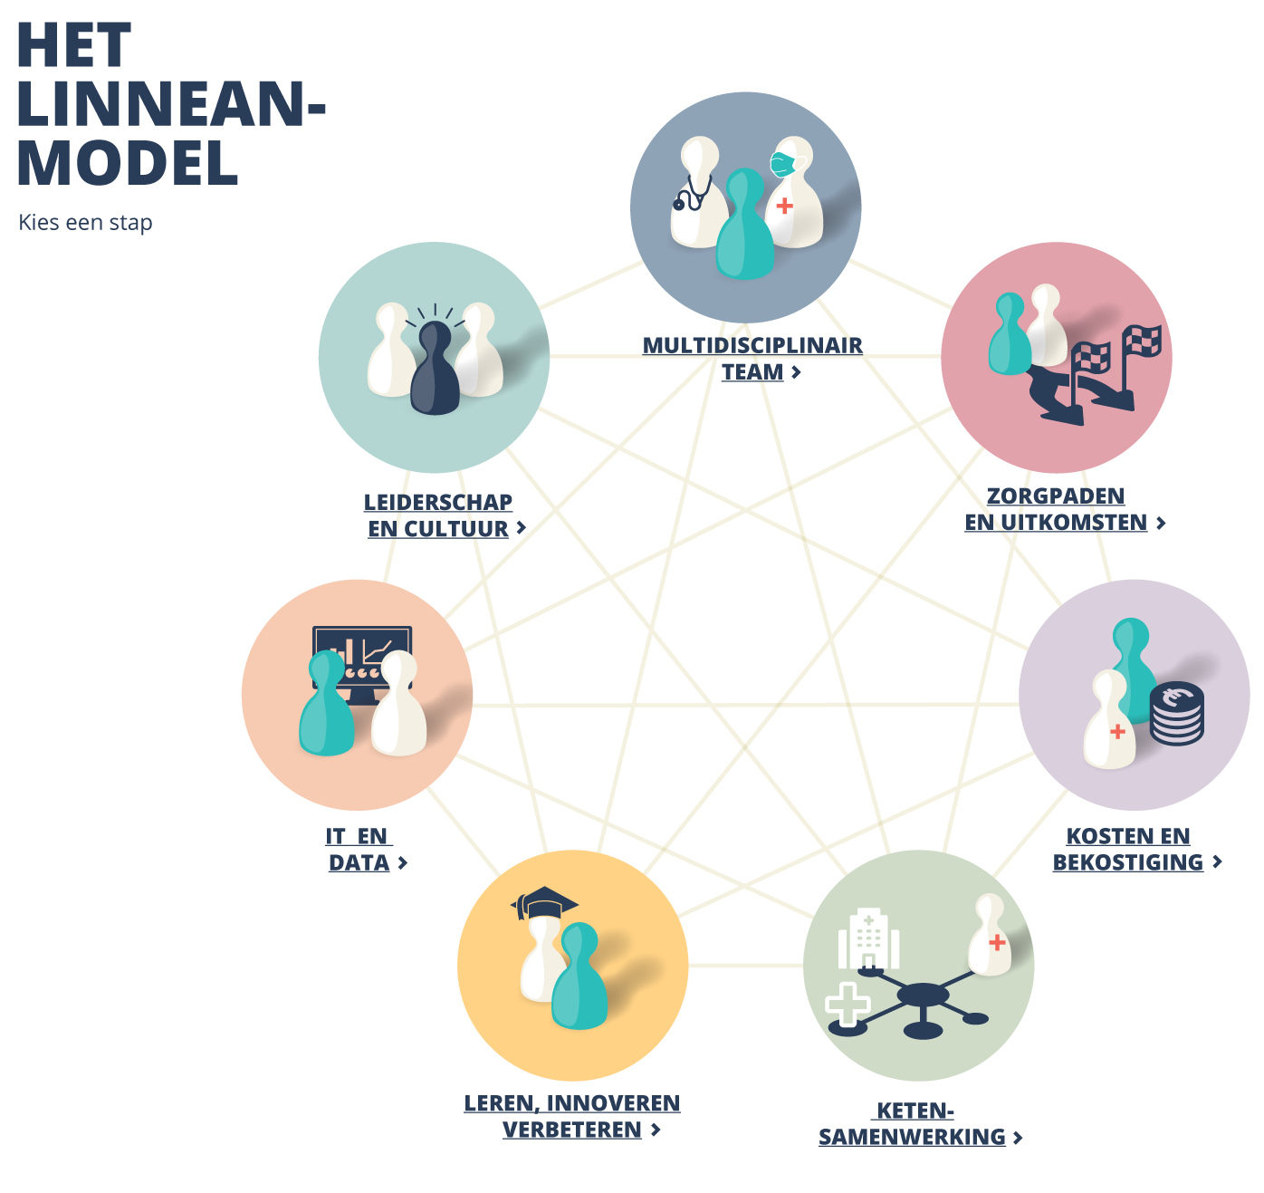

THE STRATEGY…
MULTIDISCIPLINARY TEAM
CULTURE
& LEADERSHIP
CARE PATHWAYS
& OUTCOMES
IT & DATA
COSTS & REIMBURSEMENT
LEARNING
& IMPROVING
CARE COLLABORATIONS
Linnean Initiatief – ICHOM Conference 2023 – Workshop Getting Started with VBHC
Notes:
Matthijs
Hoe de handreiking tot stand is gekomen
De opzet van de workshop verder.

Slide 8


MULTIDISCIPLINARY TEAM
MISSION
Multidisciplinary team consists of doctors, nurses, paramedics, support staff, managers and patients.
Team has joint responsibility for health outcomes and costs.
Team is led by a leader(ship team)
Relevant stakeholders engaged
Resources allocated
QUICKSCAN
Are all healthcare professionals and support staff involved sufficiently represented in our team?
Are patients represented in the evaluation and improvement of our care?
Do multidisciplinary progress and improvement meetings take place on a regular basis?
Linnean Initiatief – ICHOM Conference 2023 – Workshop Getting Started with VBHC
Notes:
Arie, Michele + Joliene
Uitleg QuickScan ‘where do you stand in your VBHC implementation?’
Iets anders dan de checklist vragen die in de boekjes staan (of na afloop ophalen)
Think of the medical condition that you and your local team work on & get a pencil and paper…
Let’s all individually score the following 3 items on a scale from 1 (not at all) to 5 (totally)
Calculate your average/total score

Slide 9
MULTIDISCIPLINARY TEAM
TIPS
Goals are clear & achievable and are shared by the team members;
Clearly define the (medical) condition and identify different treatment options;
Mirror the multidisciplinary team with the care pathway;
Give the patient a seat at the table
Involve data analyst and financial professional at an early stage.
Make progress and improvement meetings a permanent part of the PDCA cycle;
It helps when your higher management and board are involved.
TOOLS
The VBHC - house
QuickScan 'How value-based does our team work?
Whitepaper Condition-oriented Organizational Models by Linnean (2021)
Linnean Initiatief – ICHOM Conference 2023 – Workshop Getting Started with VBHC
Notes:
Niet toelichten

Slide 10

CAREPATHS & OUTCOMES
MISSION
Care path described and visualized
Choice aids and points of shared-decision making
Outcomes of care
  Outcomes set
  Collection
  Visualization in dashboard
QUICKSCAN
Is the care pathway well described and are health outcomes (Clinical and PROs) and casemix variables structurally measured for the medical condition?
Are individual health outcomes discussed with the patient (as part of shared decision making)?
To what extent are outcome data used to continuously improve care in our team?
Linnean Initiatief – ICHOM Conference 2023 – Workshop Getting Started with VBHC
Notes:
Willem Jan, Michele en Joliene

Slide 11


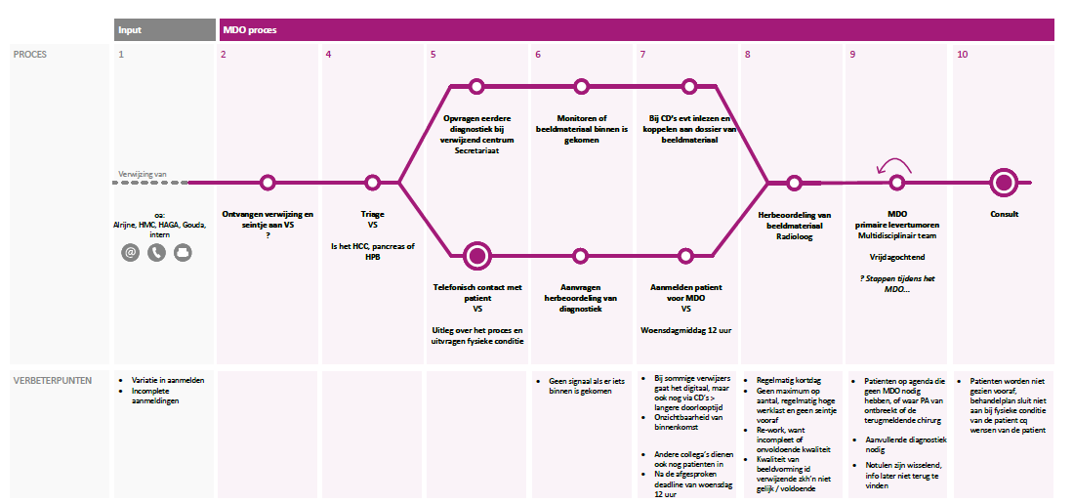
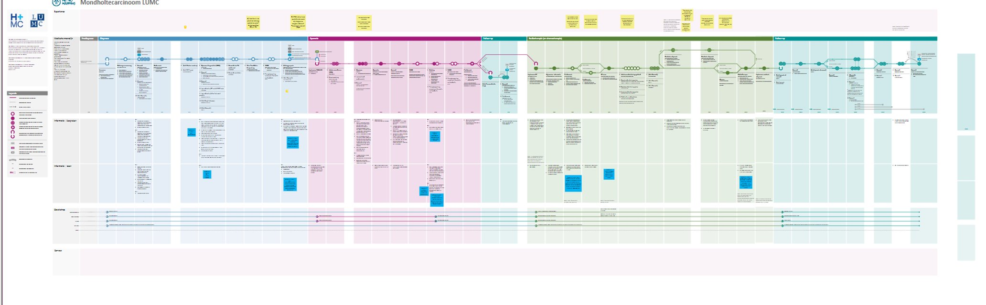
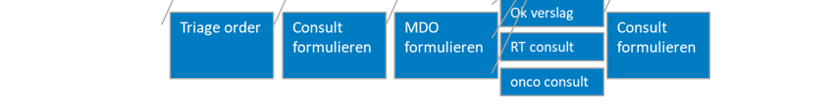
CAREPATHS & OUTCOMES
Linnean Initiatief – ICHOM Conference 2023 – Workshop Getting Started with VBHC

Slide 12
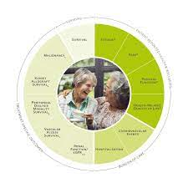

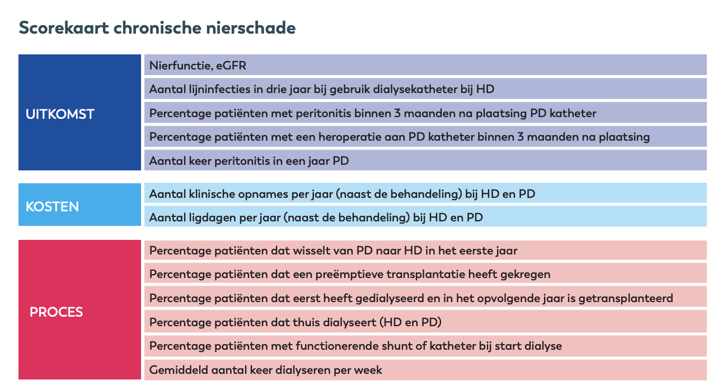
CAREPATHS & OUTCOMES
Outcomes, example Chronic Kidney Disease:
- National registrations
ICHOM
Santeon scorecard
  Outcomes, process, costs
Program Outcome-Based Healthcare
Linnean Initiatief – ICHOM Conference 2023 – Workshop Getting Started with VBHC

Slide 13
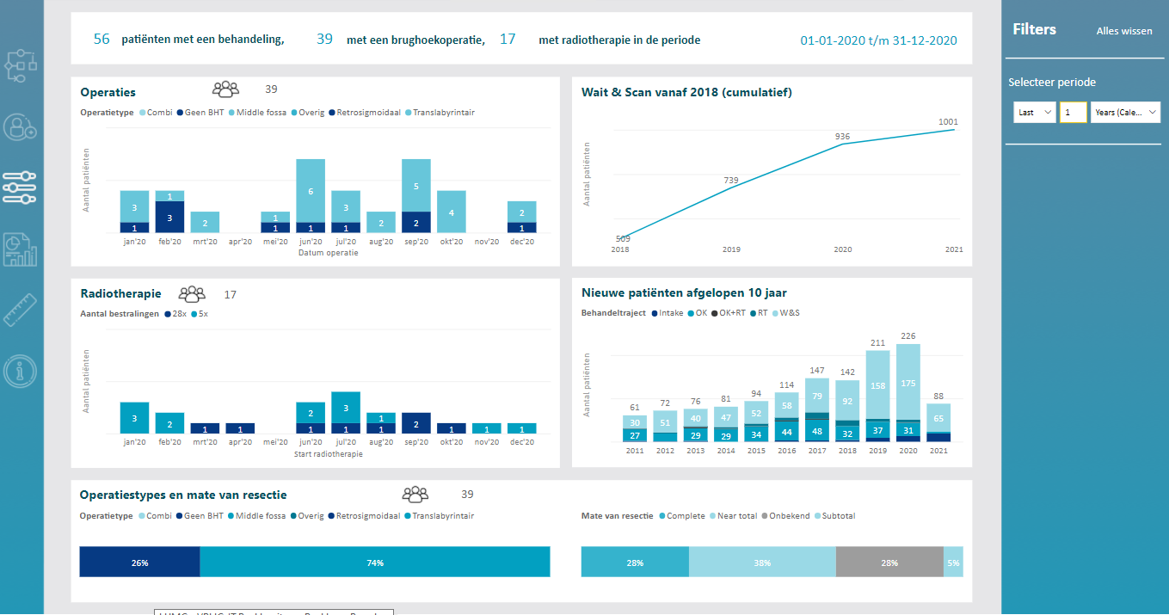
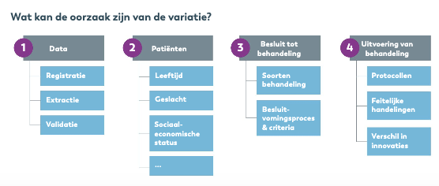
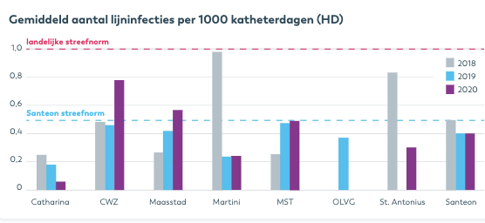
CAREPATHS & OUTCOMES
Discuss outcomes
Data visualisation
Benchmarken
  Time
  Peers
Linnean Initiatief – ICHOM Conference 2023 – Workshop Getting Started with VBHC

Slide 14
CAREPATHS & OUTCOMES
TIPS
Jointly defining the carepath with the multidisciplinary team often leads to improvements and greater mutual understanding;
Don't reinvent the wheel and be pragmatic. Start with what is already available in terms of outcomes, information about case mix and measurement moments and connect as much as possible to what has already been developed (nationally & internationally such as ICHOM;
Make clear agreements about measurement moments and validated questionnaires so that you continue to compare apples to apples;
Inform the patient about the purpose of PROMs and discuss them in the consultation room.
TOOLS
Advice set of generic PROMs (adults | children)
Outcome sets from the Outcome-Based Healthcare program and ICHOM, but also from the professional group or quality registrations if applicable
PREM booklet by Linnean (2021)
Tools related to visualizing the care path such as Metro Mapping and Care Delivery Value Chain
Tools and training materials related to shared decision making, including road map
Linnean Initiatief – ICHOM Conference 2023 – Workshop Getting Started with VBHC
Notes:
Niet toelichten

Slide 15

COSTS & REIMBURSEMENTS
MISSION
Insight in costs across the entire carepath.
Improvements based on insight in outcomes and costs
Value-based payment agreements to encourage the delivery of the best care.
QUICKSCAN
Do we know the costs and reimbursements related to the medical condition ?
To what extent is our team financially responsible?
Are there agreements with healthcare insurers on value-based contracts/payments?
Linnean Initiatief – ICHOM Conference 2023 – Workshop Getting Started with VBHC
Notes:
Willem Jan, Michele en Joliene

Slide 16
COSTS & REIMBURSEMENTS
TIPS
Connect the medical and financial worlds by involving a financial professional in the multidisciplinary team;
Improvement initiatives can be better prioritized based on outcomes and costs;
All hospitals in the Netherlands use an approximate Activity-Based Costing (ABC) cost price calculation;
Be pragmatic; start with the largest cost drivers;
You cannot solve the financing issue by focusing on financing.
TOOLS
Whitepaper on Value based care with outcomes and costs by Linnean (2021)
Playlist 'Value based payment’ on Youtube
Linnean Initiatief – ICHOM Conference 2023 – Workshop Getting Started with VBHC
Notes:
Niet toelichten

Slide 17

CARE COLLABORATIONS
MISSION
Integrated care/cooperation in the chain/network
Governance structure and joint responsibility
QUICKSCAN
To what extent are all healthcare providers in the entire (internal and external) care chain part of our team?
Is the entire care chain jointly responsible for both outcomes and costs?
To what extent are good practices shared outside our care chain to learn from?
Linnean Initiatief – ICHOM Conference 2023 – Workshop Getting Started with VBHC
Notes:
Arie, Michele en Joliene

Slide 18
CARE COLLABORATIONS
TIPS
For patients, care usually does not start when they enter a hospital and certainly does not stop when they leave;
Involve chain partners in the multidisciplinary team;
Substitution of care affects the patient population within your healthcare organization.
TOOLS
Whitepaper Condition-oriented Organizational Models
Stakeholder- & Network Analyses
Linnean Initiatief – ICHOM Conference 2023 – Workshop Getting Started with VBHC
Notes:
Niet toelichten

Slide 19

LEARNING & IMPROVING
MISSION
Common understanding of VBHC principles
Improving care based on feedback on
  Outcomes
  Logistics / costs
  Patient experiences
  Research
Transparency
QUICKSCAN
To what extent is the philosophy of value-based health care known to all healthcare professionals and support staff involved?
Is there an integrated quality policy, which also includes outcomes and costs?
Are health outcomes and costs shared and/or compared with regional or (inter)national parties?
Linnean Initiatief – ICHOM Conference 2023 – Workshop Getting Started with VBHC
Notes:
Willem Jan, Michele en Joliene

Slide 20
LEARNING & IMPROVING
TIPS
A basic level of knowledge among all MDT members is essential.
Also ensure onboarding of new employees!
TOOLS
Value based care: a necessary base in the training courses
Literature study: What works in the implementation of value-driven care and why?
PDCA cycle
Santeon scorecard
Linnean Initiatief – ICHOM Conference 2023 – Workshop Getting Started with VBHC
Notes:
Niet toelichten

Slide 21

DATA & IT
MISSION
IT and data systems that help.
The relevant data is findable, accessible, interoperable and reusable.
Clear feedback in dashboards.
Secure IT environment.
QUICKSCAN
Are outcome data unambiguously recorded at the source?
Are outcome data available in real-time?
Is outcome data displayed in useful overviews for the team?
Linnean Initiatief – ICHOM Conference 2023 – Workshop Getting Started with VBHC
Notes:
Willem Jan, Michele en Joliene

Slide 22

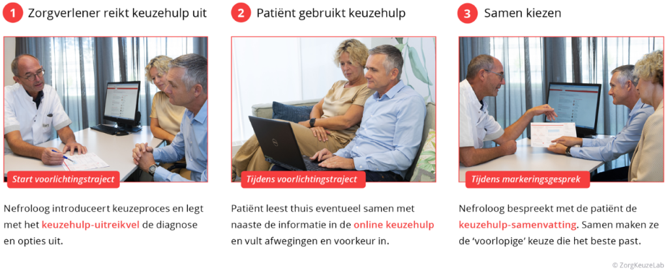
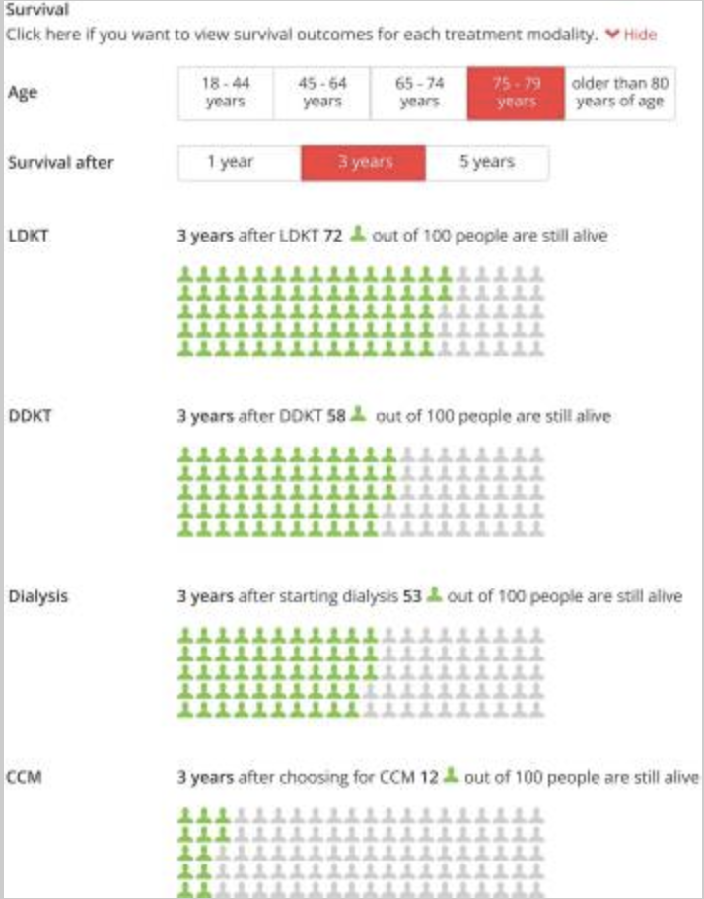
Dashboards
Team
Patients
Engels et al BMC Nephrol 2022 en vd Horst et al Int J Med Inform 2022
Linnean Initiatief – ICHOM Conference 2023 – Workshop Getting Started with VBHC
Notes:
Willem Jan

Slide 23
DATA & IT
TIPS
Do you know your CIO is and IT-agenda cycle?
Involve a data analyst and BI specialist in the multidisciplinary team;
The first step is to work with your IT or data partner to identify which connections need to be made to uncover the desired insights/indicators. Simply put: which systems should 'talk to each other’?;
Unique data definition (= terminology and structure) is crucial.
TOOLS
White paper: Optimal Use of Data/IT for Shared Decision Making
In 7 steps to a value-driven healthcare dashboard
Healthcare information building blocks from Nictiz (NL)
Linnean Initiatief – ICHOM Conference 2023 – Workshop Getting Started with VBHC
Notes:
Niet toelichten

Slide 24

CULTURE & LEADERSHIP
MISSION
VBHC is a fundamental change in the way healthcare is organized and delivered;
VBHC implementation is a team sport;
It’s all about the people;
Leadership practices what they preach;
Atmosphere of trust and safety, learning and improvement.
QUICKSCAN
Is/are the leader(s) inspiring and have good communication skills?
Do all members of the multidisciplinary team know their roles and take responsibility?
Is there a culture of enthusiasm and trust within the team, of learning and improving safely together?
Linnean Initiatief – ICHOM Conference 2023 – Workshop Getting Started with VBHC
Notes:
Arie, Michele en Joliene

Slide 25
CULTURE & LEADERSHIP
TIPS
Are you aware that value-based care is a fundamental change in organizing and delivering care? Implementing WGZ is therefore not an easy task, but a change process;
Ensure that the multidisciplinary team is truly multidisciplinary;
A good leader, preferably a leadership team, is essential!
TOOLS
Generic profile and job descriptions for leaders (medical; nurse)
Linnean Initiatief – ICHOM Conference 2023 – Workshop Getting Started with VBHC
Notes:
Niet toelichten

Slide 26


FINAL REMARKS
Please find the booklet ‘Getting Started with Value-Based Health Care’ on your table;
Scan the QR-code and leave your email adress in order to:
  Receive the ‘Getting started with Value-Based Health Care’ booklet in PDF and print version;
  Receive the link to the complete ‘Getting started with Value-Based Health Care’ manual;
  Receive this presentation including links to the tools.
Linnean Initiatief – ICHOM Conference 2023 – Workshop Getting Started with VBHC
Notes:
Matthijs

Slide 27
THANKS! QUESTIONS?
Arie Franx
a.franx@erasmusmc.nl
Michele van der Kemp
michele@vdkmp.com
Joliene Munier
jolienemunier@live.nl
Willem Jan Bos
w.bos@antoniusziekenhuis.nl
Matthijs van der Linde
mlinde@zinl.nl |
linnean@zinl.nl
Linnean Initiatief – ICHOM Conference 2023 – Workshop Getting Started with VBHC
Notes:
Allen

